Slide 1
DISCUSSION CONTENTS
Babur (Zahir al-Din Muhammad)
20 April 1526 – 26 December 1530
26 December 1530 (aged 47)
Humayun (Nasir al-Din Muhammd)
26 December 1530 –17 May 1540
22 February 1555 – 27 January 1556
27 January 1556 (aged 47)
Akbar (Jalal al-Din Mahmud)
27 January 1556 – 27 October 1605
(49 years 9 months 0 days)
27 October 1605 (aged 63)
Jahangir ( Nur al-Din Muhammad)
5 October 1605 – 8 October 1627
21 years 11 months 23 days
28 October 1627 (aged 58)
Shah Jahan (Shihab al-Din Muhammad)
8 November 1627 – 2 August 1658
22 January 1666 (aged 74)
Aurangzeb (Alamgir) al-Din Muhammad)
31 July 1658 – 3 March 1707
48 years 7 months 0 days
3 March 1707 (aged 88)
Azam Shah to Bahadur Shah Zafar (15 emperiors)
14 March 1707 – 7 November 1862

Slide 2
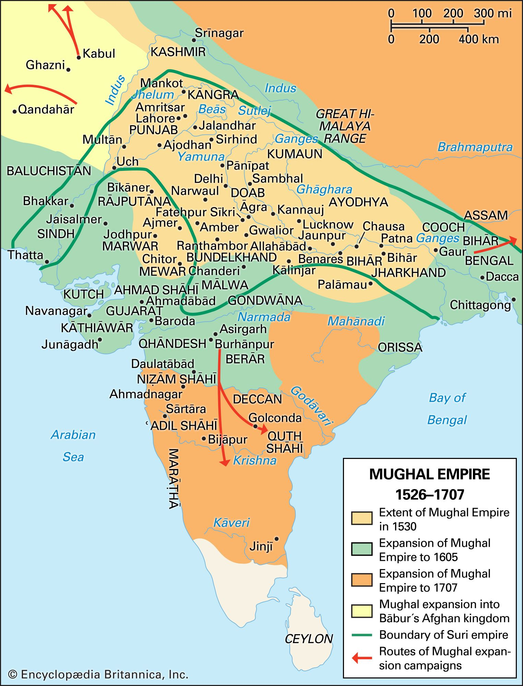
RISE OF MUGHAL EMPIRE
The Mughal Empire was an early-modern empire that controlled much of the Indian Subcontinent between the 16th and 19th centuries. For some two centuries, the empire stretched from the outer fringes of the Indus river basin in the west, northern Afghanistan in the northwest, and Kashmir in the north, to the highlands of present-day Assam and Bangladesh in the east.
The Mughal empire is conventionally said to have been founded in 1526 by Babur, a warrior chieftain from what is today Uzbekistan, who employed aid from the neighboring Safavid and Ottoman empires, to defeat the Sultan of Delhi, Ibrahim Lodhi, in the First Battle of Panipat. The Mughal imperial structure, however, is sometimes dated to 1600, to the rule of Babur's grandson, Akbar. This imperial structure lasted until 1720, until shortly after the death of the last major emperor, Aurangzeb during whose reign the empire also achieved its maximum geographical extent. Reduced subsequently, especially during the East India Company rule in India, to the region in and around Old Delhi, the empire was formally dissolved by the British Raj after the Indian Rebellion of 1757.

Slide 3
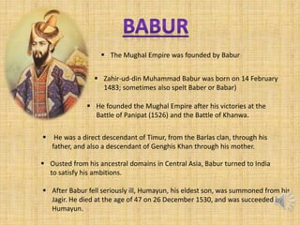
MUGHAL EMPIRE
Babur and Humayun (1526–1556)
The Mughal Empire was founded by Babur (reigned 1526–1530), a Central Asian ruler who was descended from the Turco-Mongal conqueror Timur (the founder of the Timured Empaire) on his father's side, and from Cenghis Khan on his mother's side. Ousted from his ancestral domains in Central Asia, Babur turned to India to satisfy his ambitions. He established himself in Kabul and then pushed steadily southward into India from Afghanistan. Babur's forces defeated Ibrahim Lodhi in Panipat.

Slide 4
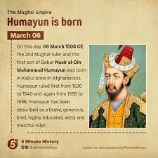
MUGHAL EMPIRE
The preoccupation with wars and military campaigns, however, did not allow the new emperor to consolidate the gains he had made in India. The instability of the empire became evident under his son, Humayun (reigned 1530–1556), who was forced into exile in Persia by rebels. The Sur Empire (1540–1555), founded by Sher Shah Suri (reigned 1540–1545), briefly interrupted Mughal rule. Humayun's exile in Persia established diplomatic ties between the Safavid and Mughal Courts, and led to increasing Persian cultural influence in the later restored Mughal Empire Humayun's triumphant return from Persia in 1555 restored Mughal rule in some parts of India, but he died in an accident the next year.

Slide 5
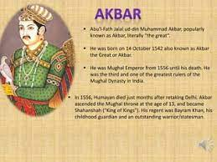
MUGHAL EMPIRE
Akbar to Aurangzeb (1556–1707)
Akbar (reigned 1556–1605) was born Jalal-ud-din Muhammadin the Rajput Umarkot Fort, to Humayun and his wife Hamida Banu Begum, a Persian princess. Akbar succeeded to the throne under a regent, Bairam Khan, who helped consolidate the Mughal Empire in India. Through warfare and diplomacy, Akbar was able to extend the empire in all directions and controlled almost the entire Indian subcontinent. He created a new ruling elite loyal to him, implemented a modern administration, and encouraged cultural developments. He increased trade with European trading companies. India developed a strong and stable economy, leading to commercial expansion and economic development. Akbar allowed freedom of religion at his court, and attempted to resolve socio-political and cultural differences in his empire by establishing a new religion, Din-i-Ilahi, with strong characteristics of a ruler cult.

Slide 6
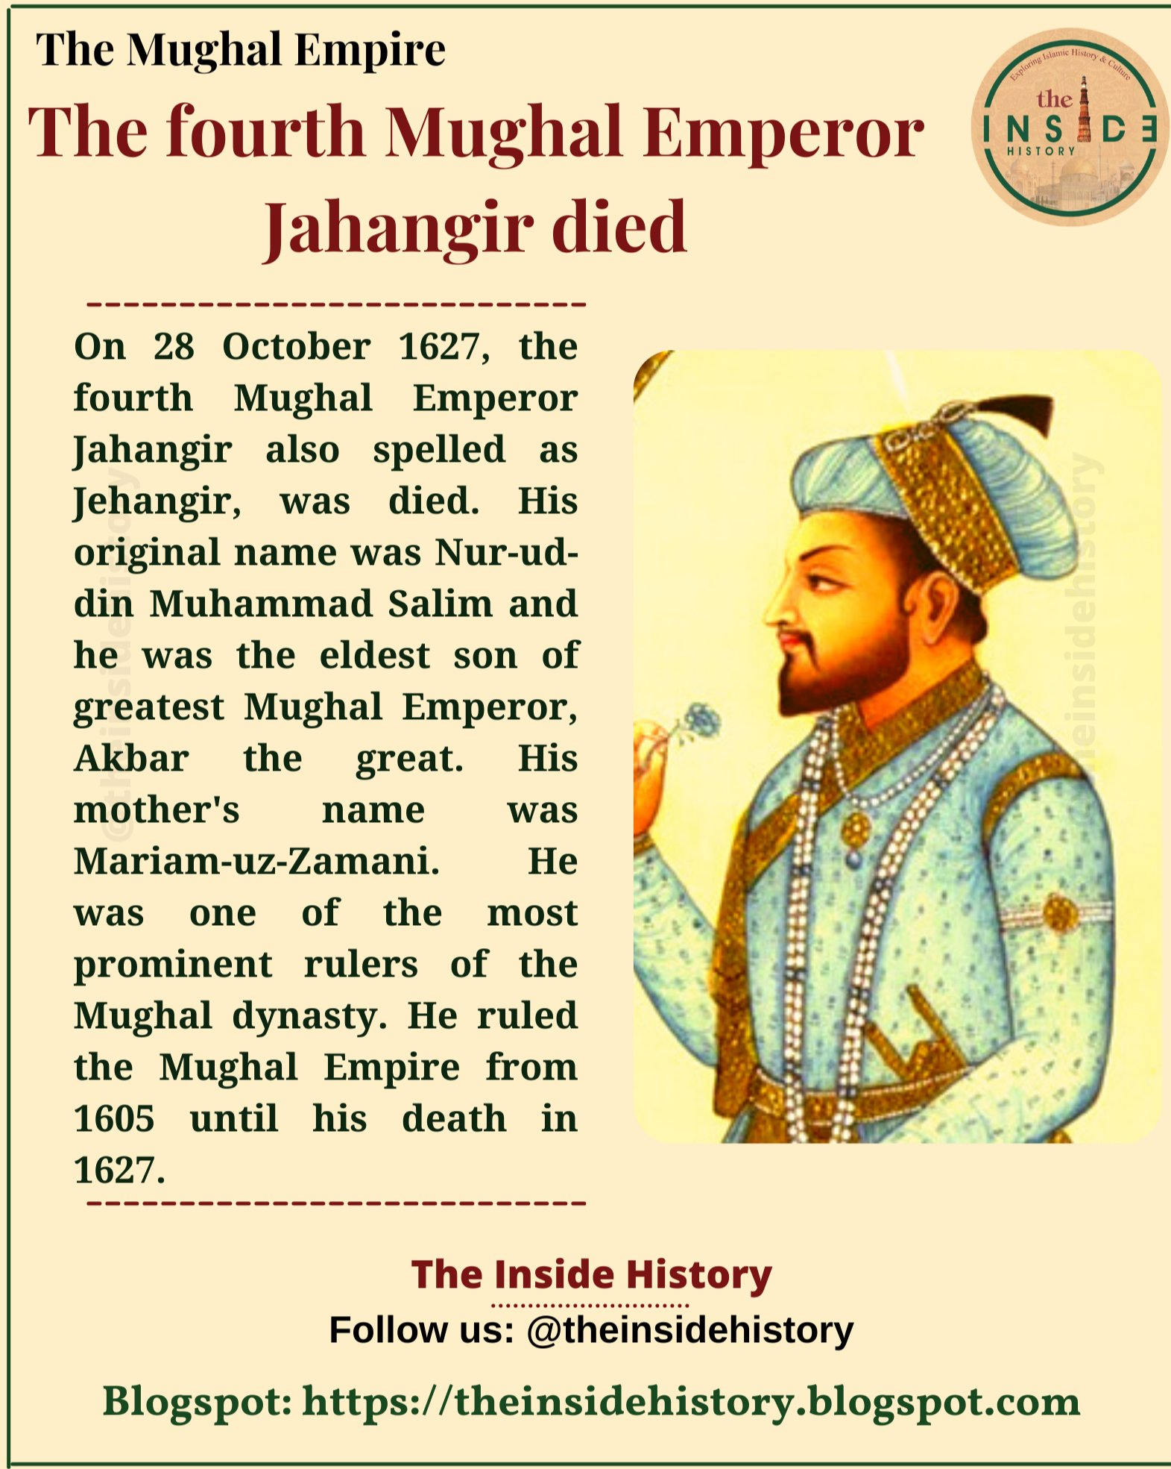
MUGHAL EMPIRE
Jahangir (1605-1627)
Jahangir was born to Akbar and his wife Mariam-un-Zamani, an Indian Rajput princess. He was addicted to opium, neglected the affairs of the state. Jahangir distinguished himself from Akbar by making substantial efforts to gain the support of the Islamic religious establishment. In contrast to Akbar, Jahangir came into conflict with non-Muslim religious leaders, notably the Sikh guru Arjan, whose execution was the first of many conflicts between the Mughal empire and the Sikh community.

Slide 7
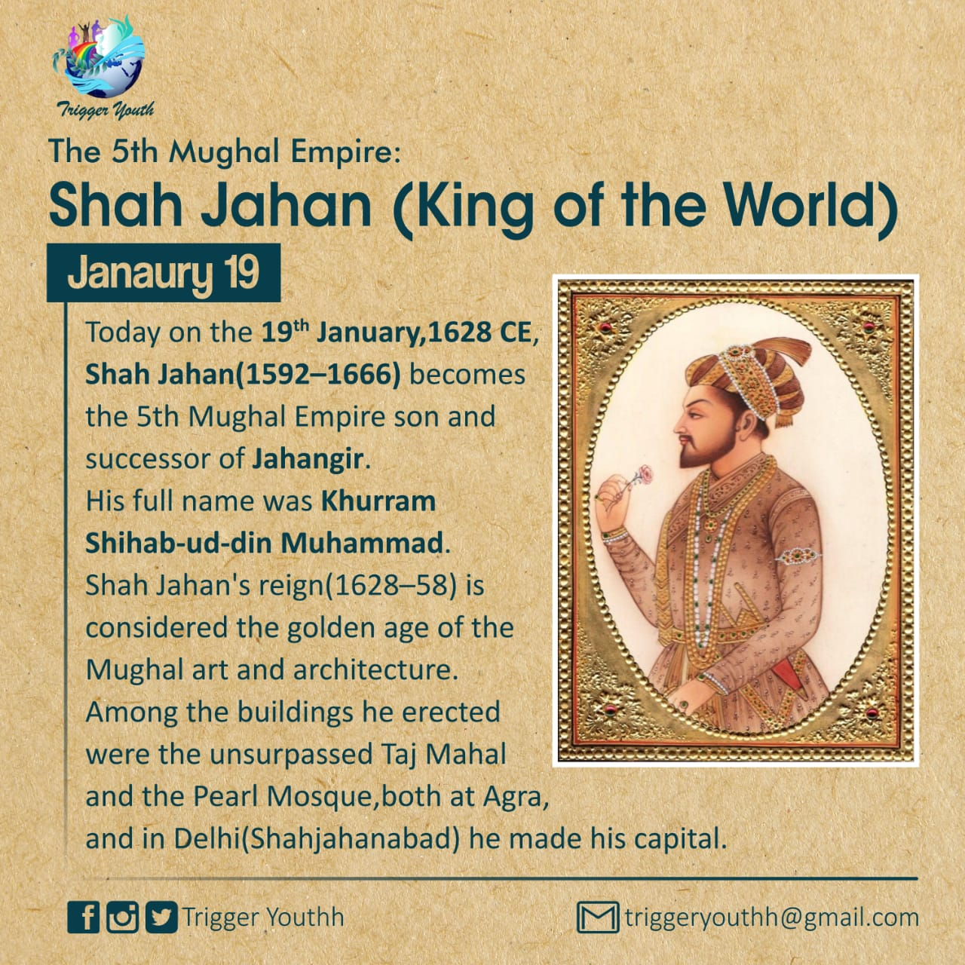
MUGHAL EMPIRE
Shah Jahan (reigned 1628–1658)
Shah Jahan was born to Jahangir and his wife Jagat Gosaini, a Rajput princess. His reign ushered in the golden age of Mughal architecture. During the reign of Shah Jahan, the splendor of the Mughal court reached its peak, as exemplified by the Taj Mahal. The cost of maintaining the court, however, began to exceed the revenue coming in. His reign was called as "The Golden Age of Mughal Architecture".

Slide 8
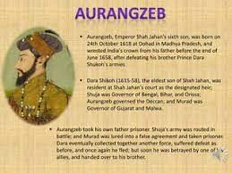
MUGHAL EMPIRE
Aurangzeb (1658–1707)
Shah Jahan's eldest son, the liberal Dara Shikoh, became regent in 1658, as a result of his father's illness. Dara championed a syncretistic Hindu-Muslim culture. Shikoh tried to re-establish Akbar’s Din-i-Ilahi religion. With the support of the Islamic orthodoxy, however, a younger son of Shah Jahan, Aurangzeb (1658–1707), seized the throne. Aurangzeb defeated Dara in 1659 and had him executed. Although Shah Jahan fully recovered from his illness, Aurangzeb kept Shah Jahan imprisoned until his death in 1666.
Aurangzeb oversaw an increase in the Islamilization of the Mughal state. He encouraged conversion to Islam, reinstated the Jizya on non-Muslims. Aurangzeb also ordered the execution of the Sikh guru Tegh Bahadur, leading to the militarization of the Sikh community. He expanded the empire to include almost the whole of South Asia, but at his death in 1707, "many parts of the empire were in open revolt".
Aurangzeb is considered India's most controversial king, with some historians arguing his religious conservatism and intolerance undermined the stability of Mughal society, while other historians question this, noting that he built Hindu temples, employed significantly more Hindus in his imperial bureaucracy than his predecessors did, opposed bigotry against Hindus and Shia Muslim.

Slide 9
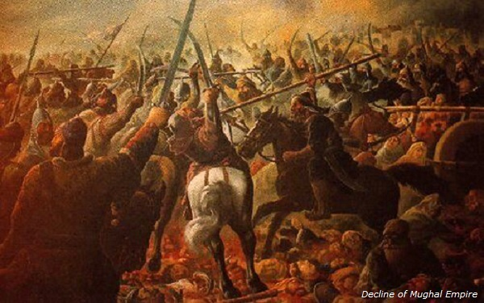
MUGHAL EMPIRE
Decline (1707–1857)
Aurangzeb's son, Bahadur Shah I, repealed the religious policies of his father and attempted to reform the administration. "However, after his death in 1712, the Mughal dynasty sank into disorder and violent feuds. In 1719 alone, four emperors successively ascended the throne". During the reign of Muhammad Shah (reigned 1719–1748), the empire began to break up, and vast tracts of central India passed from Mughal to Maratha hands.

Slide 10
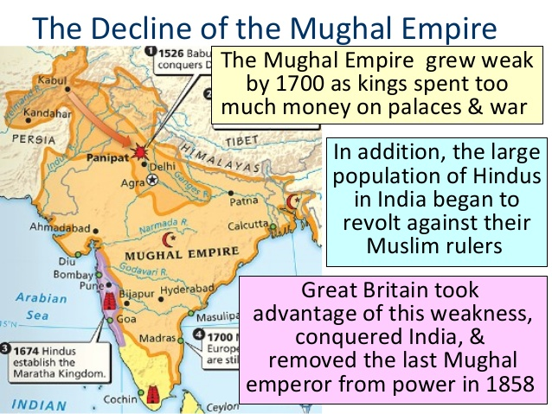
MUGHAL EMPIRE
Causes of decline
Historians have offered numerous explanations for the rapid collapse of the Mughal Empire between 1707 and 1720, after a century of growth and prosperity. In economic terms, the throne lost the revenues needed to pay its chief officers, the emirs (nobles) and their entourages. The emperor lost authority, as the widely scattered imperial officers lost confidence in the central authorities, and made their own deals with local men of influence. The imperial army, bogged down in long, futile wars against the more aggressive Marathas, lost its fighting spirit. Finally came a series of violent political feuds over control of the throne. After the execution of Emperor Farrukhsiyar in 1719, local Mughal successor states took power in region after region

Slide 11
MUGHAL EMPIRE
Titular Name | Birth Name | Period | Death | Notes
Babur | Zahir al-Din Muhammad | 20 April 1526 – 26 December 1530 | 26 December 1530 (aged 47) | Founded the Empire
Humayun | Nasir al-Din Muhammd | 26 December 1530 –17 May 1540 and 22 February 1555 – 27 January 1556 | 27 January 1556 (aged 47) | Humayun was overthrown in 1540 by Sher Shah Suri of the Afghan Suri dynasty but returned to the throne in 1555 after the death of Islam Shah Suri (Sher Shah Suri's son and successor).
Akbar | Jalal al-Din Mahmud | 27 January 1556 – 27 October 1605 (49 years 9 months 0 days) | 27 October 1605 (aged 63) | Abu'l-Fath Jalal-ud-din Muhammad Akbar famously known as Akbar The Great. Under his reign, the Mughal Empire expanded substantially, gained much prestige, and stabilization. He is considered to be the most competent ruler of the Mughal Empire. He introduced various liberal policies and had conducted several inter-religion marriages for political advantage. His successor was born to his Rajput Queen consort Mariam-uz-Zamani. Himself on his spiritual behest, he renounced Islam in later life and founded a religion named Din-I-Illahi. His mother Hamida Banu Begum was Persian.

Slide 12
MUGHAL EMPIRE
Titular Name | Birth Name | Period | Death | Notes
Jahangir | Nur al-Din Muhammad | 5 October 1605 – 8 October 1627 21 years 11 months 23 days | 28 October 1627 (aged 58) | He was the eldest surviving son of Akbar and his chief consort Mariam-uz-Zamani, a Rajput princess. He is regarded as an incapable ruler who was under the heavy influence of alcohol and opium. Despite being incompetent he is considered to be the justness ruler of the Mughal empire genuinely interested in the welfare of his subjects. Under his reign, the growing control of the Deccan regions led by Akbar began to recede.
Shah Jahan | Shihab al-Din Muhammad | 8 November 1627 – 2 August 1658 | 22 January 1666 (aged 74) | Under his reign, the Mughal Empire reached the peak of its cultural glory. Shah Jahan is best remembered for his architectural achievements. His reign ushered in the golden age of Mughal architecture. Shah Jahan commissioned many monuments, the best known of which is the Taj Mahal in Agra, in which is entombed his favorite wife, Mumtaz Mahal.

Slide 13
MUGHAL EMPIRE
Titular Name | Birth Name | Period | Death | Notes
Aurangzeb (Alamgir) | Muhi al-Din Muhammad | 31 July 1658 – 3 March 1707 48 years 7 months 0 days | 3 March 1707 (aged 88) | His mother was Persian Mumtaz Mahal. He was married to Safadiv Dynasty Princess Dilras Banu Begum. He established Islamic law throughout India. Under his reign, Mughals reached their greatest extent. After his death, His younger Son Azam Shah became the King (for 3 months)
Azam Shah to Bahadur Shah Zafar (15 emperiors) |  |  | 14 March 1707 – 7 November 1862 | Last Mughal Emperor. Deposed by the British and was exiled to Burma after the rebellion of 1857.

Slide 14
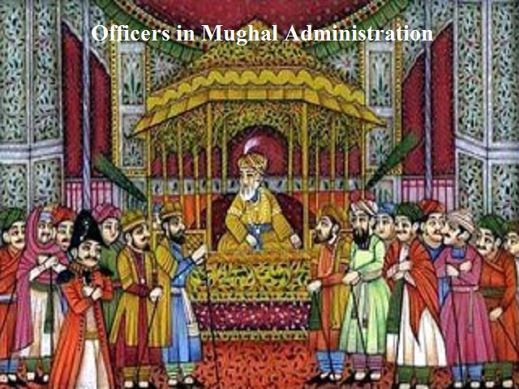
MUGHAL EMPIRE
Administration
Government - the Mughal Empire had a highly centralized, bureaucratic government, headed by the Mughal emperor. The finance/revenue ministry was responsible for controlling revenues from the empire's territories, calculating tax revenues. The ministry of the military was headed by an officially titled Mir Bakhshi, who was in charge of military and messenger service. The ministry in charge of law/religious patronage was the responsibility of the sadr as-sudr, who appointed judges and managed charities and stipends.
The empire was divided into suba (provinces), each of which were headed by a provincial governor called a Subadar. The structure of the central government was mirrored at the provincial level; each Suba had its own bakhshi, sadr as-sudr, and finance minister that reported directly to the central government rather than the Subahdar. Subas were subdivided into administrative units known as Sarker which were further divided into groups of Villages known as Parganas.

Slide 15
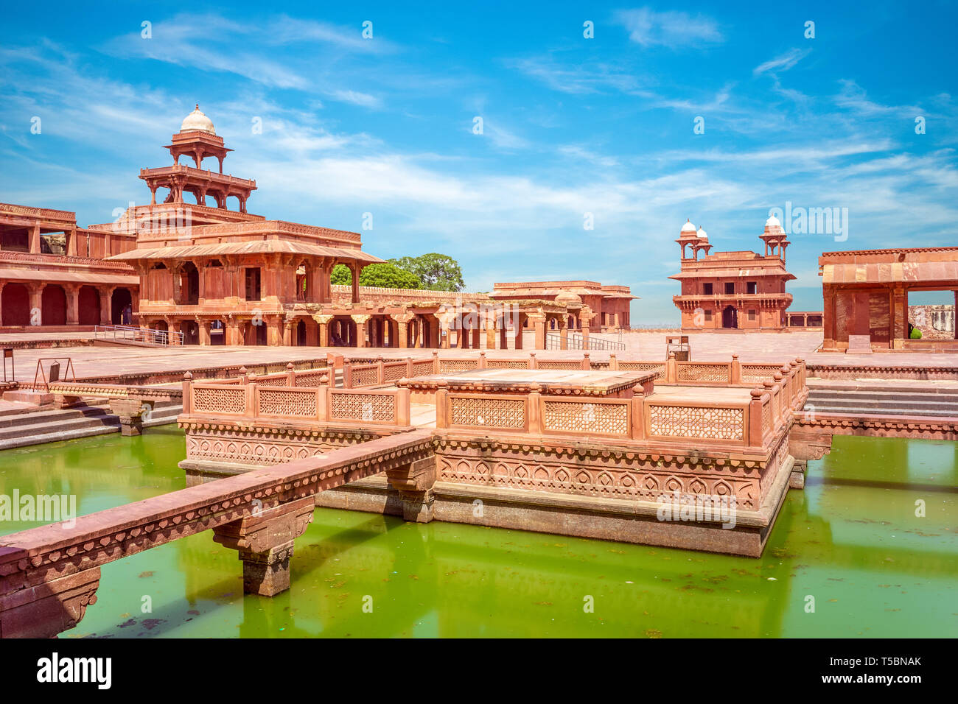
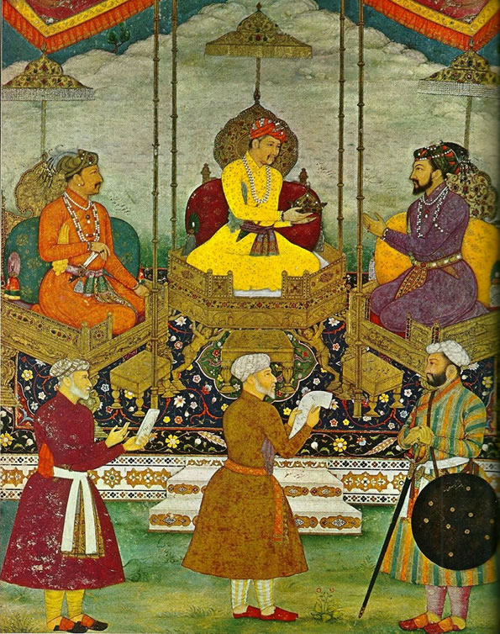
MUGHAL EMPIRE
Capitals - the Mughals had multiple imperial capitals, established over the course of their rule. These were the cities of Agra, Delhi, Lahore, and Fatehpur Sikri. Power often shifted back and forth between these capitals. Sometimes this was necessitated by political and military demands, but shifts also occurred for ideological reasons (for example, Akbar's establishment of Fatehpur Sikri).
Law - the Mughal Empire's legal system was context-specific and evolved over the course of the empire's rule. Being a Muslim state, the empire employed Fiqh and therefore the fundamental institutions of Islamic law such as Mufti, and Muhtasib (market supervisor) were established in the Mughal Empire. The Mughal Empire followed the Sunni Hanafi system.

Slide 16
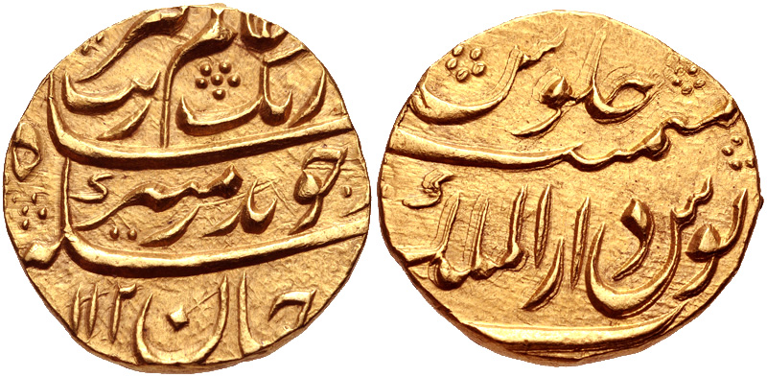
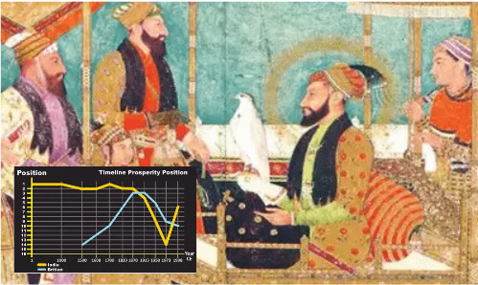
MUGHAL EMPIRE
Economy - the Indian economy was large and prosperous under the Mughal Empire. During the Mughal era, the Gross Domestic Product (GDP) of India was estimated at 22% of the World Economy, the second largest in the world, behind only Ming China but larger than Europe. By 1700, the GDP of Mughal India had risen to 24% of the world economy, the largest in the world, larger than both Qing China and Western Europe.
Mughal empire was producing about 25% of the world's industrial output up until the 18th century. The Mughals were responsible for building an extensive road system, creating a uniform currency, and the unification of the country. The main base of the empire's collective wealth was agricultural taxes, instituted by the third Mughal emperor, Akbar.

Slide 17
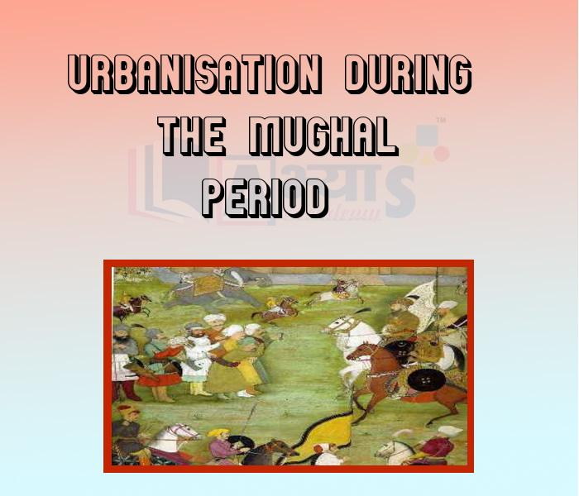
MUGHAL EMPIRE
Urbanization - according to Irfan Habib Cities and towns boomed under the Mughal Empire, which had a relatively high degree of urbanization for its time, with 15% of its population living in urban areas. This was higher than the percentage of the urban population in contemporary Europe, at the time, the urban population of England, Scotland and Wales did not exceed 13% of its total population. The historian Nazimuddin Ahmed reported that, under Akbar's reign, there were 120 large cities and 3200 townships. A number of cities in India had a population between a quarter-million and half-million people, with larger cities including Agra (in Agra Subah) with up to 800,000 people, Lahore (in Lahore Subah) with up to 700,000 people, Dhaka (in Bengal Subah) with over 1 million people, and Delhi (in Delhi Subah) with over 600,000 people.

Slide 18
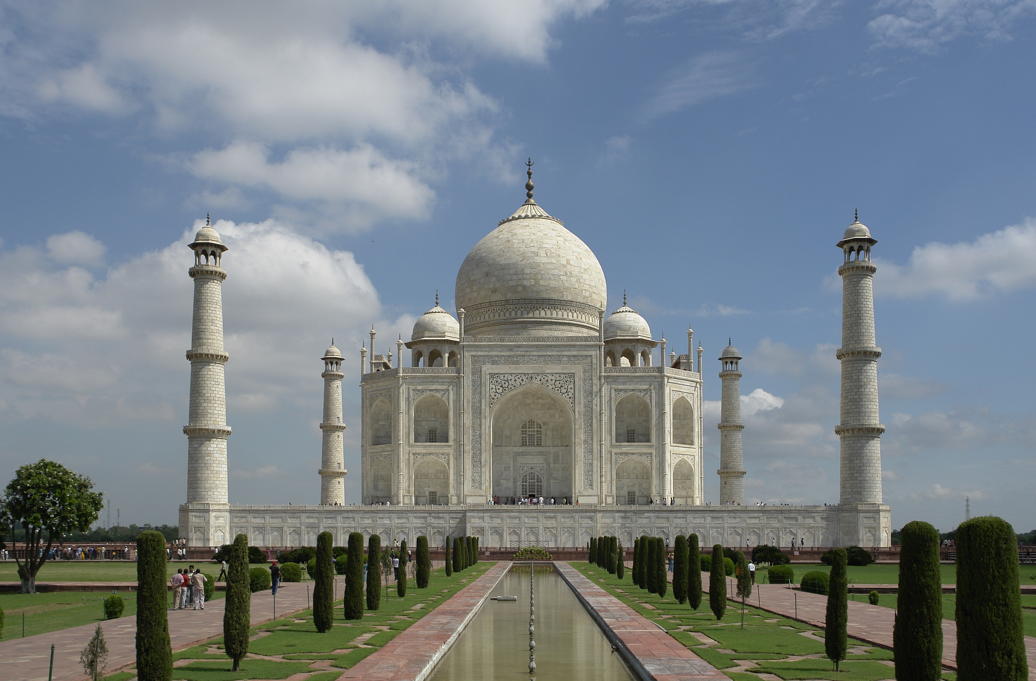
MUGHAL EMPIRE
Architecture - The Mughals made a major contribution to the India subcontinent with the development of their unique Indo-Persian architecture. Many monuments were built during the Mughal era by the Muslim emperors, especially Shah Jahan, including the Taj Mahal—a UNESCO World Heritage Site. The palaces, tombs, gardens and forts built by the dynasty stand today in Agra, Delhi, Dhaka, Fatehpur Sikri, Jaipur Lahore Kabul, and many other cities of India, Pakistan, Afghanistan, and Bangladesh.

Slide 19


